Slide 1

Data Scientist With Python
Student Name: Abdullah Khan
UID: 21BCS10510
Email ID: 21BCS10510@cuchd.in
DISCOVER . LEARN . EMPOWER

Slide 2
TOPICS TO BE COVERED
Introduction
About Technology
Weekly Schedule
Certification Done
Conclusion and Future Scope
References

Slide 3
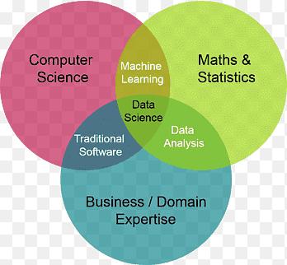
INTRODUCTION
It is about using data to make better decisions.
It is a rapidly growing field with a high demand for qualified workers.
It is a multidisciplinary field that uses scientific methods to extract knowledge and insights from data.
Data scientists use their skills in mathematics, statistics, computer science, and domain expertise to solve real-world problems.
It has a wide range of applications in business, healthcare, science, and other fields.

Slide 4
ABOUT TECHNOLOGY
Programming languages: Python, R, SQL
Cloud computing platforms: AWS, Azure, GCP
Machine learning libraries: TensorFlow, PyTorch, scikit-learn
Data visualization tools: Tableau, Power BI, Matplotlib
Big data processing tools: Hadoop, Spark
Data warehousing tools: Snowflake, BigQuery
Data mining tools: RapidMiner, SAS Enterprise Miner
Natural language processing tools: spaCy, Gensim

Slide 5
WEEKLY SCHEDULE
Weekly schedule followed for course completion:
Week 1: Introduction to Python
Week 2: Data Manipulation with Pandas
Week 3: Introduction to Data Visualization with Matplotlib
Week 4: Exploratory Data Analysis in Python
Week 5: Introduction to Regression with Statsmodels in Python
Week 6: Supervised Learning In Python
Week 7: Machine Learning with tree based Model

Slide 6
CERTIFICATION
Certification Title: Data Scientist With Python
Total Number of Certificates: 1
Issuing Organization: DataCamp
Certification Description: I'm happy to say that I've completed my Data Science certification. This certification shows that I know the basic ideas and important skills in Data Science. It proves that I'm good at the main principles of Data Science.

Slide 7
CONCLUSION AND FUTURE SCOPE
Data science is a rapidly growing field with a high demand for qualified workers.
Data scientists use their skills in mathematics, statistics, computer science, and domain expertise to solve real-world problems.
Data science has a wide range of applications in business, healthcare, science, and other fields.
Future Scope:
AI and ML will become increasingly important in data science applications.
Data scientists will need to develop new ways to process and analyze big data.
Data scientists with domain expertise will be in high demand.

Slide 8
References
https://app.datacamp.com/learn/career-tracks/data-scientist-with-python?version=8

Slide 9
THANK YOU

